Slide 1




Unicorn Introduction

Slide 2

Contents
Introduction
Features
Reliability

Slide 3
01
01
Introduction

Slide 4
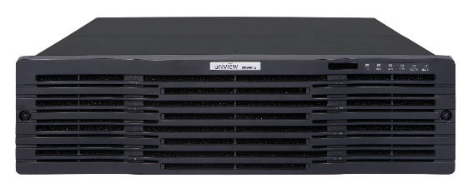
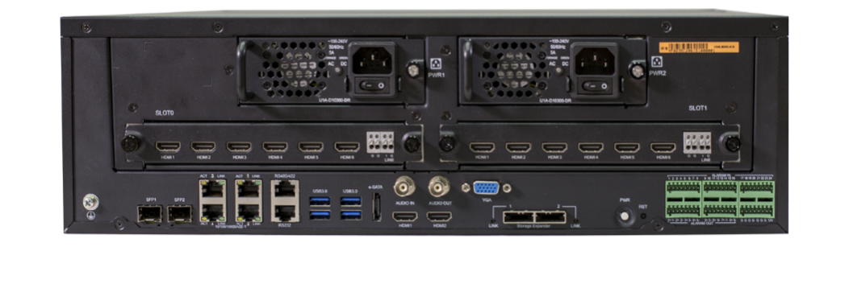
What is Unicorn
Unicorn is an easy-to-deploy, scalable, and reliable management platform integrated with Manage, Store, Decode and Transfer functions for IPC, NVR, encoder, decoder, network keyboard and cloud devices.

Slide 5
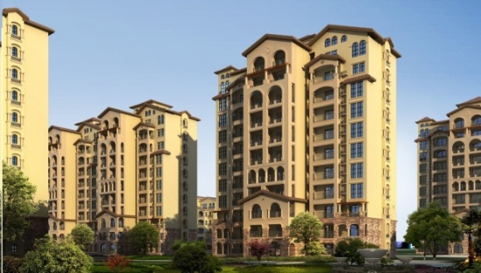

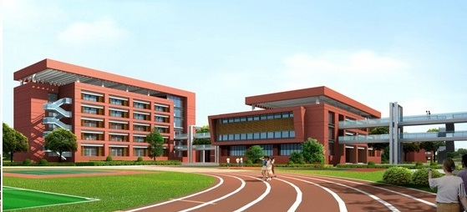


Applications
Suitable for video surveillance scenarios with 200~1000 cameras.
Residential area
Office building
School
Museum
Shopping mall

Slide 6
Application ——Advantages of Networking with Unicorn
Advantages
Client
IPC
Easy to deploy and scale
Highly reliable (Linux)
Distributed storage
Video saved on NVR 24/7 and on Unicorn as backup
Service load balance
Surveillance deployable from Unicorn or NVR
Management server
IP network
Forwarding server
Storage server
NVR
Decoder
Unicorn
Video Wall
Storage device
Play animation in full screen

Slide 7
Typical Networking--LAN
Live view, storage, playback and alarm services available on VMS client with IPC, NVR, Unicorn and VMS client on the same LAN.

Slide 8
Typical Networking--WAN
Live view, storage, playback, alarm services available on VMS client with IPC and NVR connected to Unicorn from Internet.
Typical applications: Chained stores or construction sites (etc) that are connected through network.
Prerequisites:
Unicorn has a fixed public IP address.
Devices shall have public IPs; otherwise, they shall connect via EZCloud (max cloud devices: 64 ).
Sufficient bandwidth for Unicorn, NVR, IPC, and VMS client to ensure video service.

Slide 9
Typical Networking--WAN
Unicorn can manage IPC and NVR connected from Internet (see illustration below). Users can also perform configuration operations remotely from a PC client or mobile app.
Means devices or VMS client connected
from Internet

Slide 10
Ultra 265
More than just a compression technology, it is a solution which could save 75% of cost.
Uniview - Top 3 H.265 based solution provider
H.265
U-Code
+
=
Ultra 265
Industrial Standard
Algorithm Innovation
Best H.265 solution

Slide 11
Ultra 265
The most advanced video compression technology in video surveillance
The deep video compression technology of Uniview to reduce the bitrate based on H.265
+
=
U-Code
Technology
H.265
Ultra 265
Control bitrate depending on the video content
Bitrate
control
Separate moving target and static background with different codec
Dynamic GOP
Deep
Video compression
Keep good image quality
Image quality

Slide 12
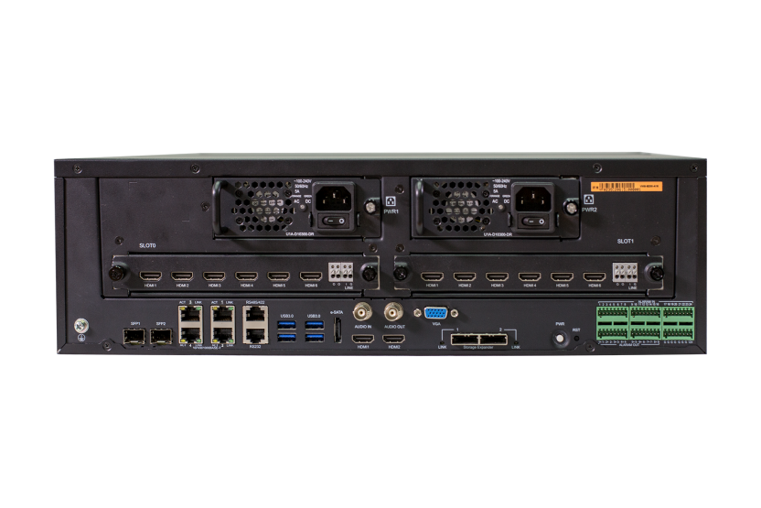
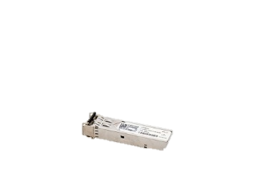
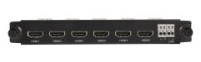
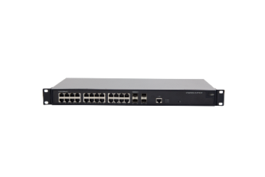

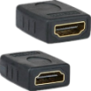
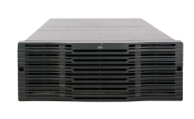



Abundant Ports & Interfaces
Easy to deploy and maintain,
saving cost and providing peace of mind
Optical module
Optional
Decoding card
Network switch
Alarm device
4K
Debugging device
Decode & output
Disk enclosure

Slide 13
02
02
Features

Slide 14

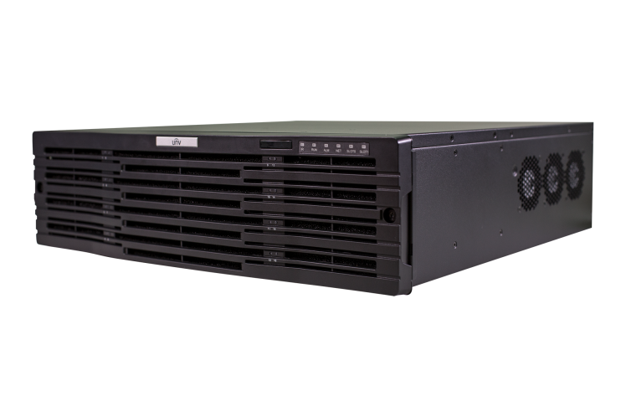
Unified Management of Different Devices
IPC
NVR
Encoder
Network keyboard
Decoder
Third-party IPC connectable
by standard ONVIF

Slide 15


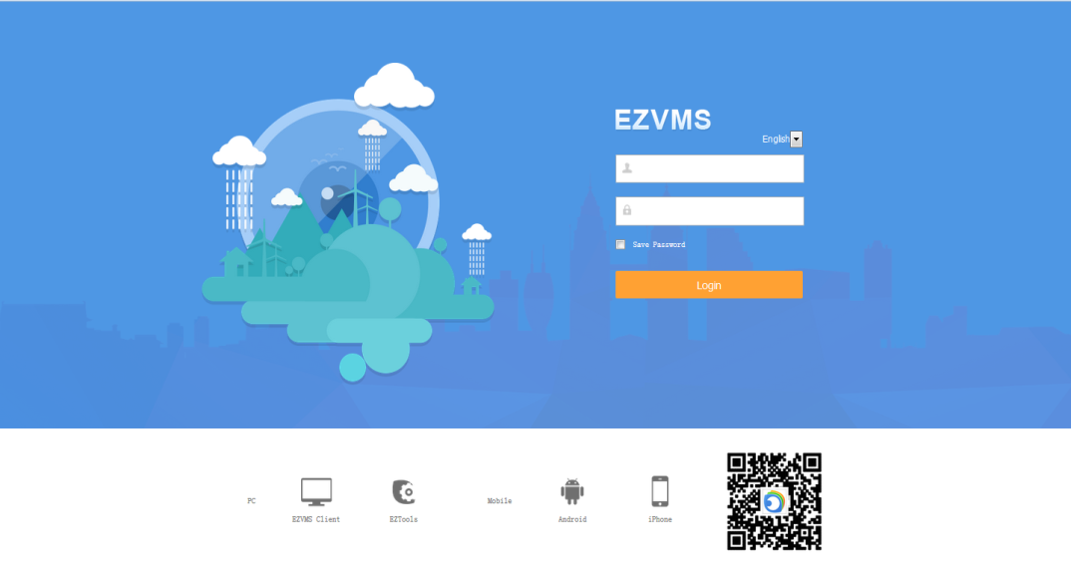
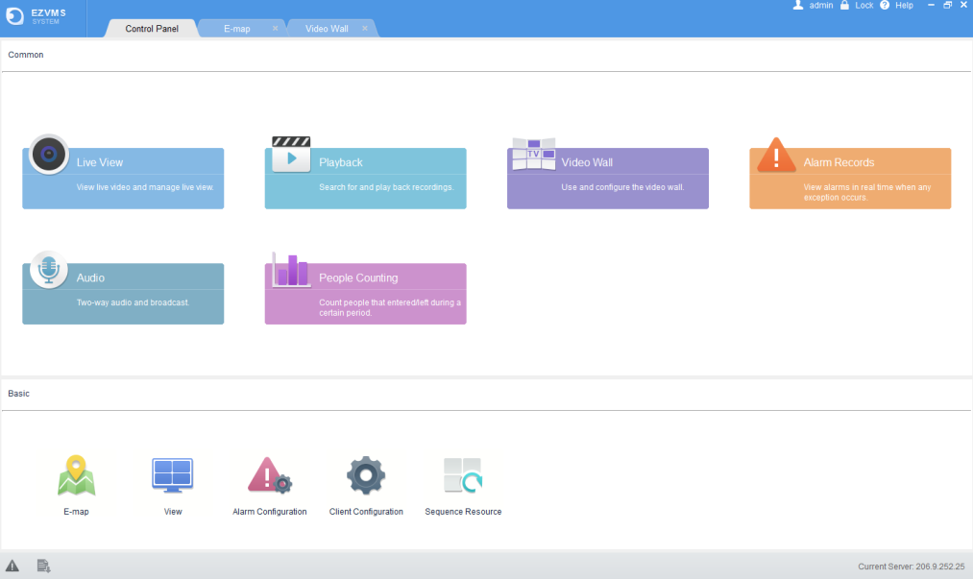
Unified Management with BS Client and CS Client
B/S client
Web access, mainly for configurations (e.g., add devices, manage permissions)
C/S client
Client software, mainly for operations (e.g., live view, playback, video wall)
IE9, Edge, Chrome32, FireFox29, Opera20
Download on login page of B/S client

Slide 16
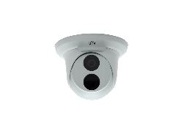
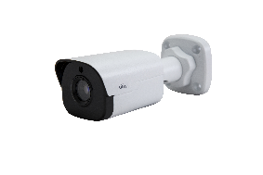

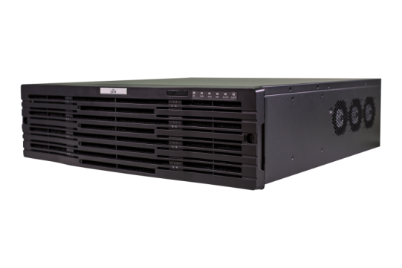

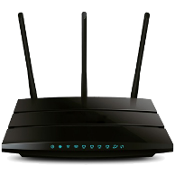



Unified Management with App
EZView
Live video, playback, device sharing, anytime, anywhere
Real-time alarm notifications
Wi-Fi/3G/4G
Internet
Play on your Smart phone
Notes:
在App Store或Google Play Store搜索EZView，下载安装并注册P2P账号；
添加Unicorn设备到该账号下，即可实现：
查看实况、回放录像
收藏实况布局、一键开启实况
告警推送、事件列表查询
分享设备给客户、家人、朋友

Slide 17
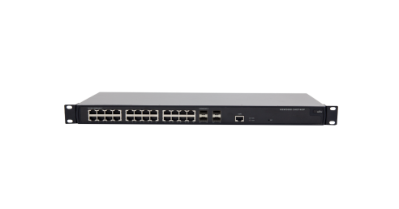
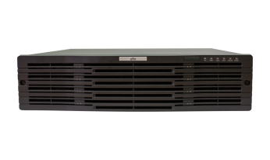
Capacity Expansion with Master/Slave Configuration
Add slave Unicorn (up to 8) to expand storage and transfer capacity, access with one IP (of master Unicorn).
A slave Unicorn provides an extra 512M/256-ch storage and 384M transfer capacity and can connect to 2 disk enclosures.
Need more storage bandwidth/channels?
Unicorn
(master)
Need more transfer bandwidth?
Unicorn (slave)
Need more input bandwidth/channels?
……
Unicorn (slave)

Slide 18
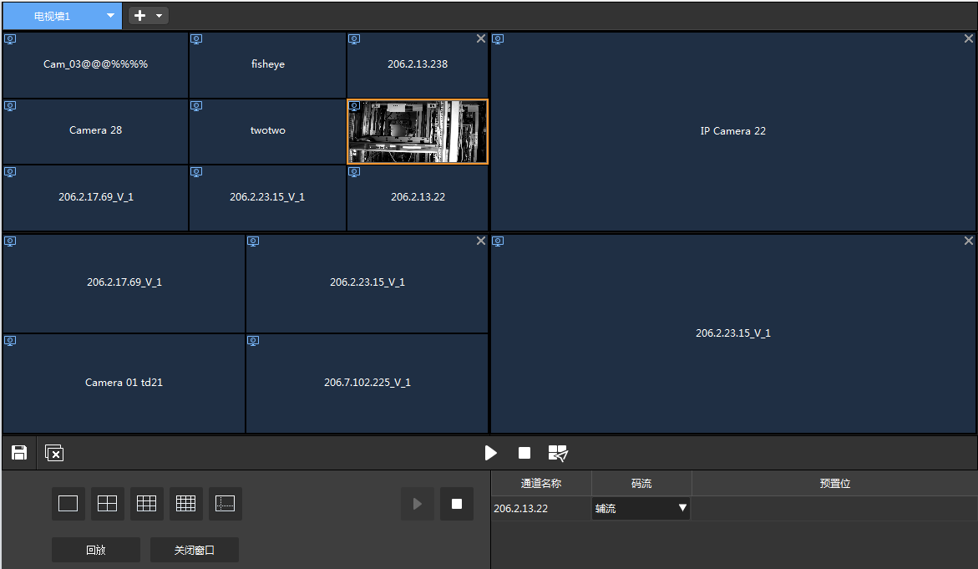

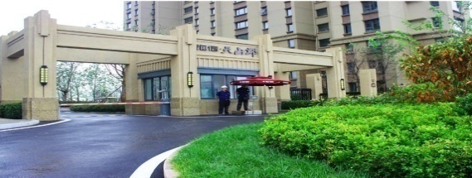



Decode and Video Wall
3 video outputs for live view, sequence, playback and alarm-triggered video
Multiple window layouts on C/S client, up to 64 windows on one screen
Display over 200 video channels simultaneously (with an extra decoding card)
Save video wall settings as a scene and restart service with one click of button
Notes:
本机：
单个口解码路数≤16路1080P
三个口解码路数总和≤16路1080P
HDMI口均支持4K显示
扩展：(解码卡最大支持6口）
单个口解码路数≤16路1080P
每两个口解码路数总和≤16路1080P

Slide 19

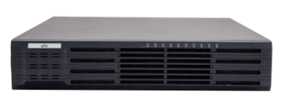
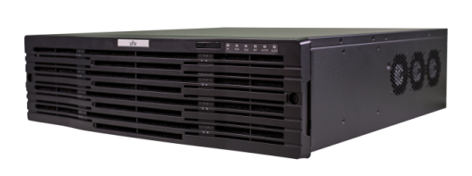
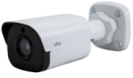
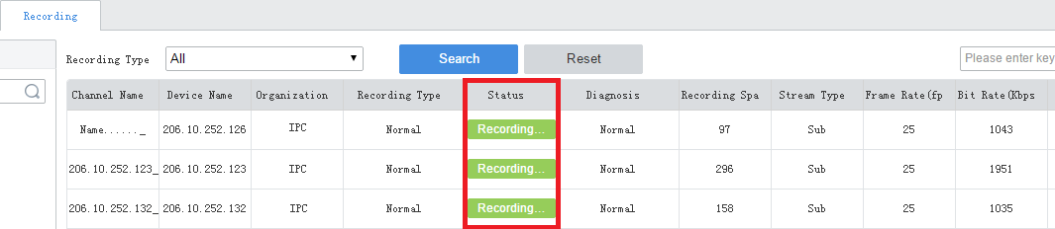
Central Storage
Scheduled recording
Save stream from specified IPC to Unicorn via NVR in real time according to recording schedule configured on Unicorn
NVR
Unicorn
…….
Network
…….
Note: Central storage is unavailable when Unicorn and NVR are not on the same LAN.
Recording status query

Slide 20



Central Backup (planning)
Video from cameras are saved to NVR by default.
Save an extra copy to Unicorn if necessary.
NVR
Network
…….
…….
Unicorn

Slide 21
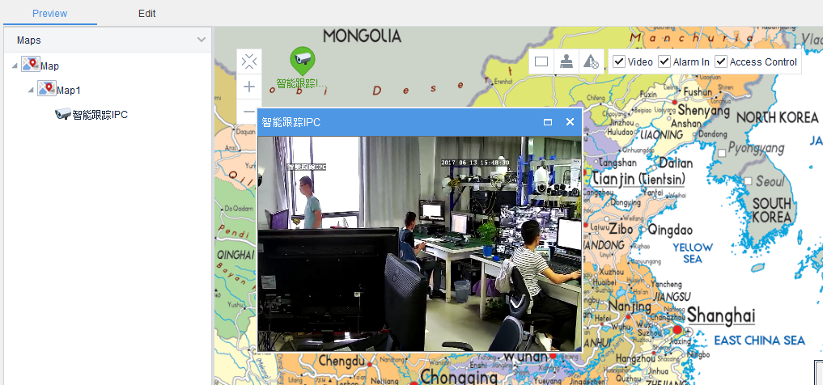
E-map
Multiple map formats (JPG, PNG, BMP)
7-layer of maps
Live view & playback on map
Alert with flashing icon

Slide 22
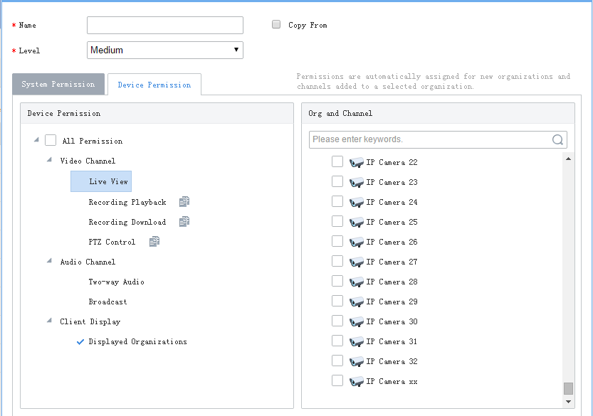
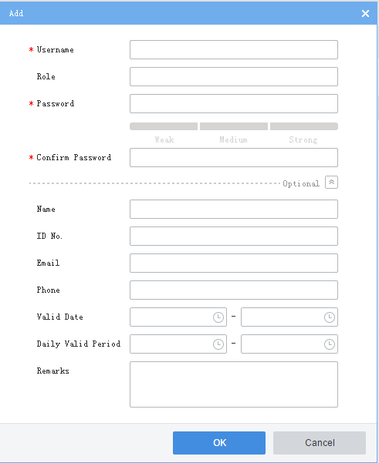
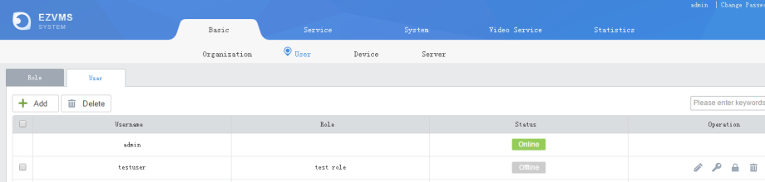
Permission Management
01
Role-based permission management
02
Account validity period, specified login time, and account lock
Role, including system permissions and device permissions, specifies accessible devices/channels and allowed configurations/operations.
Login is allowed during specified period(s) only.
User cannot log in when locked.
Click to lock.
Assign device permissions

Slide 23
Operation & Management (more functions are being planned)
Channel info and online/offline status
Channel Status
Recording Status
Info about video recording to Unicorn
Device info and online/offline status
Device Status
Alarm Logs
Query and acknowledge alarms
Server status
HDD detection
Network status
User status
Bandwidth Statistics
Server Statistics
Operation Logs
Query operation logs.
Keep track of the system at all times!

Slide 24
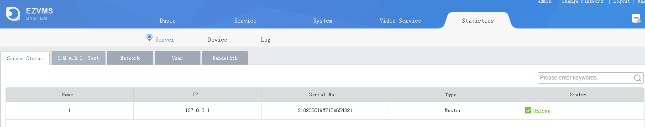
Operation & Management--Server Statistics

Slide 25
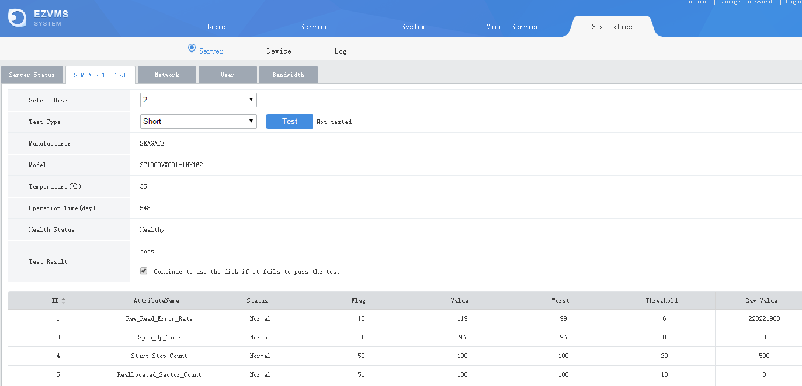
Operation & Management--Server Statistics

Slide 26
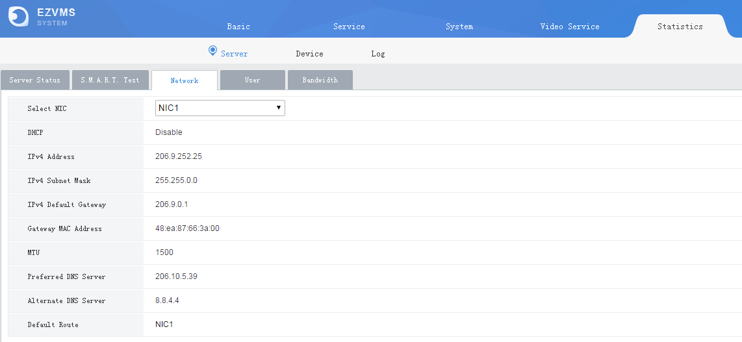
Operation & Management--Server Statistics

Slide 27
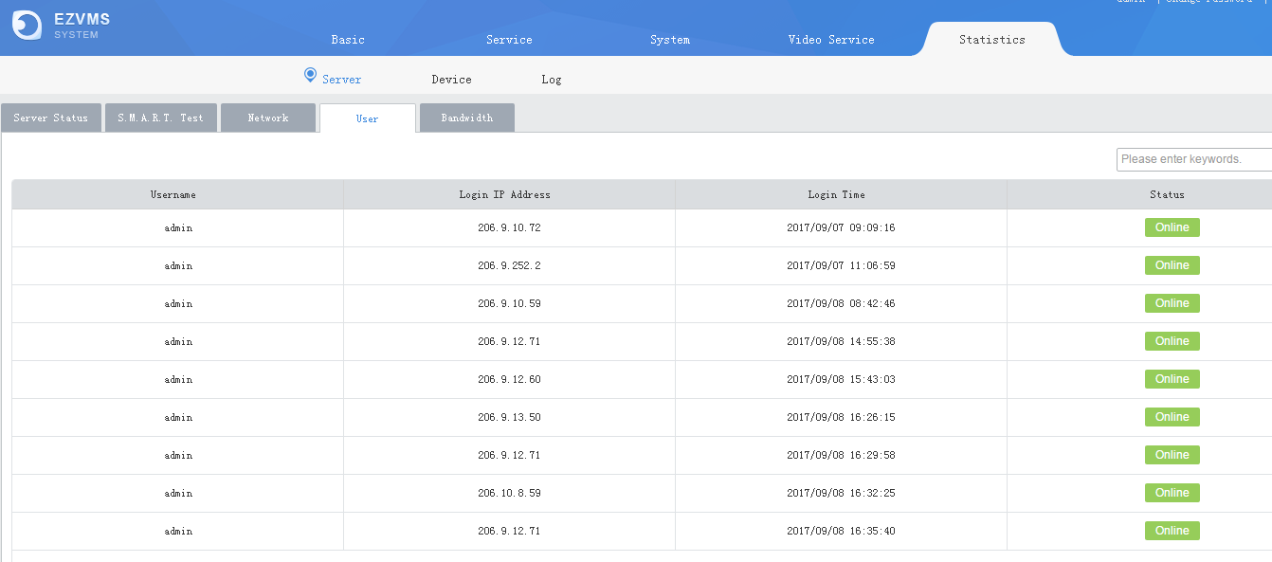
Operation & Management--Server Statistics

Slide 28
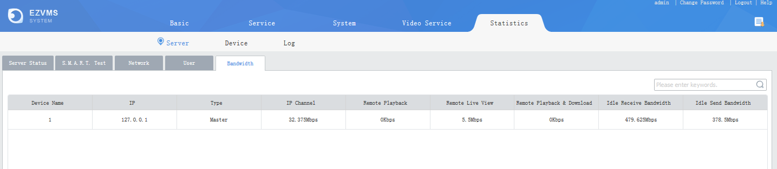
Operation & Management -- Server Statistics
Show idle input and output bandwidth in real time

Slide 29
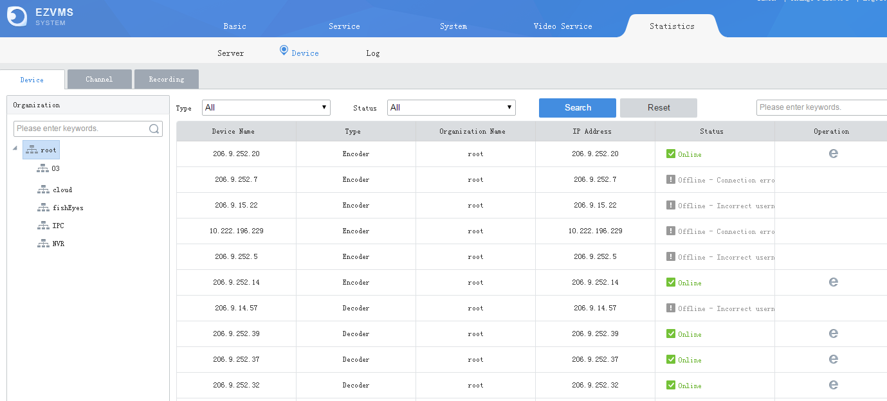
Operation & Management--Device Status

Slide 30
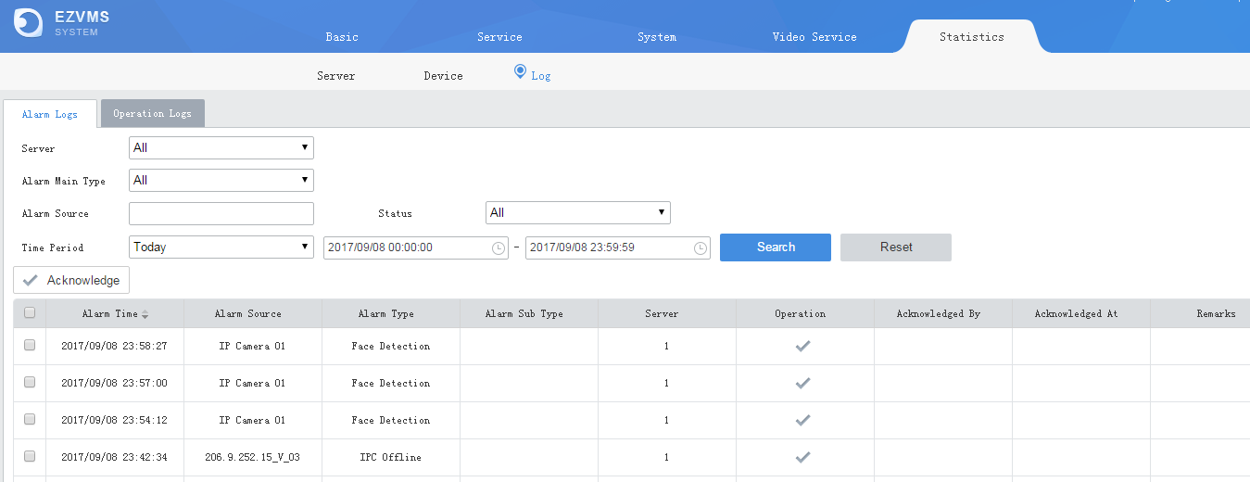
Operation & Management--Log Status

Slide 31
03
03
Reliability

Slide 32
Quality- Rigorous R&D test
8
System reviews
37
Product level functional tests
418
Board tests
22
Environment and reliability tests
201
Product tests
Uniview has always pushing the edge of high quality.
We scrutinize every element and chip, carefully selected all materials.
Each detail was meticulously designed, engineered, and crafted until products had the industry-leading quality.

Slide 33
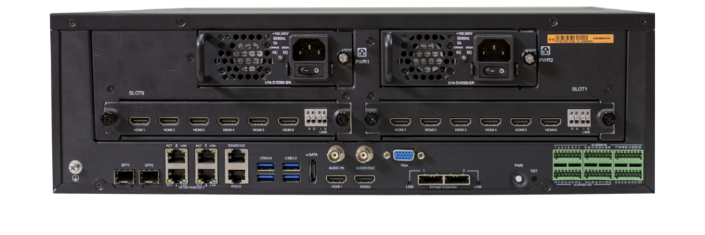
Architecture - Dual Network Interfaces
1.Multi-address mode
Two IP addresses for connection to two different networks (one for local access and the other for remote)
2.Load Balance mode
Automatically balance the throughout, combine 2 Gigabyte Ethernet interface to one
3.Fault-tolerant mode
Automatically enable the backup port when the main port failed

Slide 34
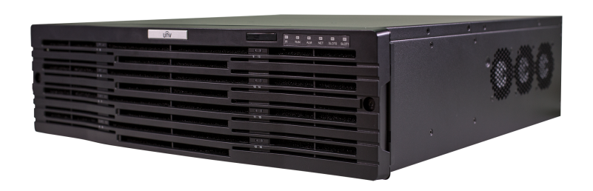
Hardware – Intelligent Fan
Automatically adjust fan speed according to different temperatures.
Fan Speed RPM
5000
3000
6 Efficient heat dissipation with fans
51
60
Temp℃
Change fan speed by temperature
≥60℃: high speed
＜51℃: low speed

Slide 35
Hardware – Dual BIOS
Dual BIOS ensure high reliability of system running
BIOS 1
BIOS 2

Slide 36
Hardware – Redundant Power Supply
Power supply
Data integrity
Redundant
Power supply
In case of power failure, redundant power supply takes over to keep normal working.

Slide 37
Software
Embedded
Linux OS
More Secure
Multiple
network protections
Telnet On/Off
802.1x
HTTPS
ARP Protection

Slide 38
Thank you!

